Slide 1
Easy Housing Solution

Slide 2
Done By:
Abhilash Naidu Veluri – 172280
Mentor:
Manish Rajhans

Slide 3
Objectives
Project Understanding
Approach used
Project Execution
Modules
Learning
Best Practices
Opportunity for improvement
Demo and Code Walkthrough
Q&A
Notes:
Add instructor notes here.

Slide 4
Abstract
This project is aimed at developing Easy Housing Solution (EHS) for administrators and Customers. It is proposed to develop a system to provide web based Housing Solution system which will allow users to study, compare, buy, sell & then maintain his/her property details in a systematic way. Typical operations include registering and login of the user, searching houses for buying or renting. Owners can add their property, upload images and get the property verified from the Easy Housing Company.

Slide 5
Project Understanding
In this project Buyer can able to Search for the Houses. After he/she finds there required House they can contact property owner.
In this project there is access for both Admin Buyer and seller.
Seller can able to add new Houses and also gives information about the details of House.
In this project Admin have rights to verify the property ,which was uploaded by the
We have used ADO.NET and WPF to create the UI pages and CRUD operations.
Username and Password are required to login to the page.

Slide 6
Approach Used
Presentation Layer – WPF 4.5
Business Layer - Business Logic Components and Services: c# 5.0
Database Layer – DATABASE:SQL Server 2012

Slide 7
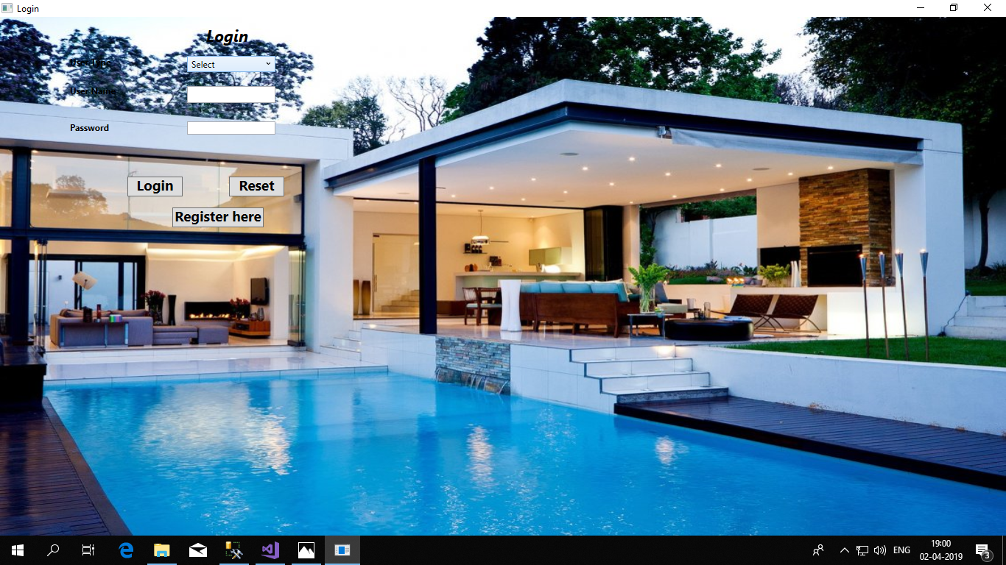
PROJECT EXECUTION

Slide 8
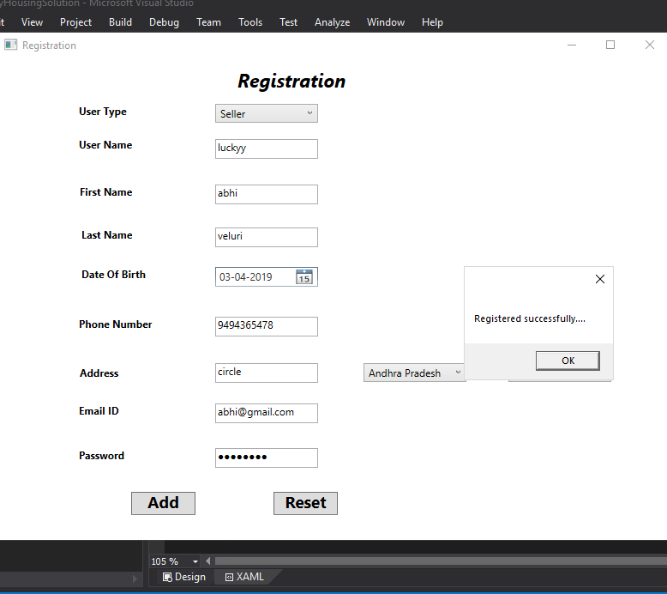
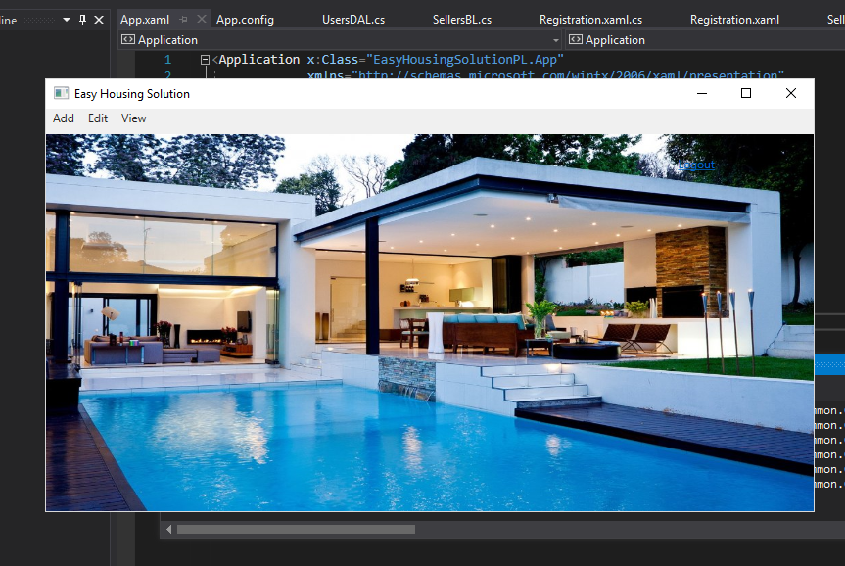

Slide 9
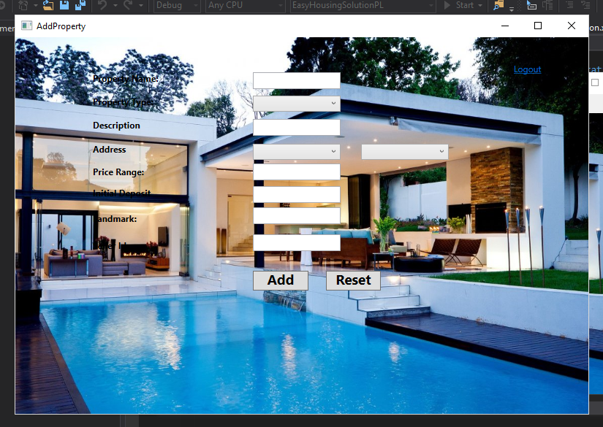
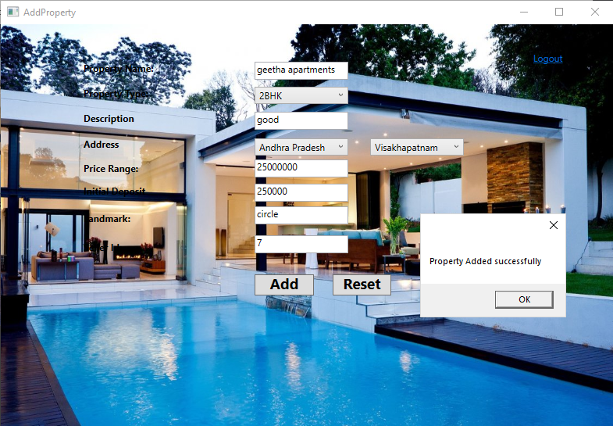

Slide 10
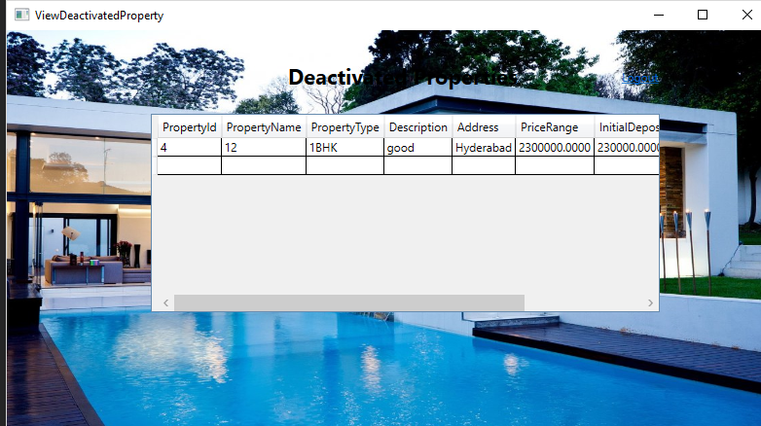
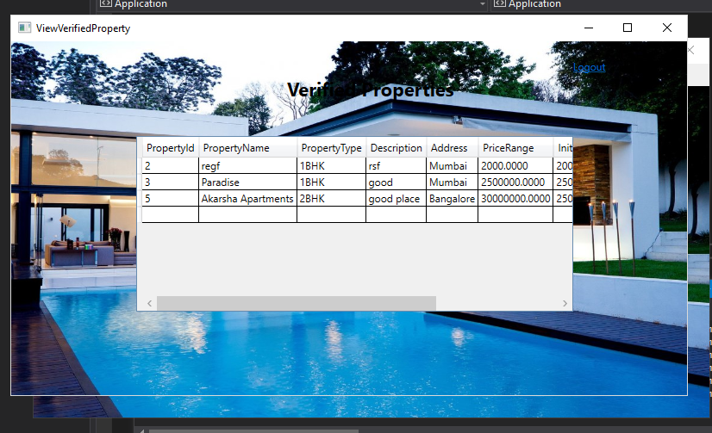

Slide 11
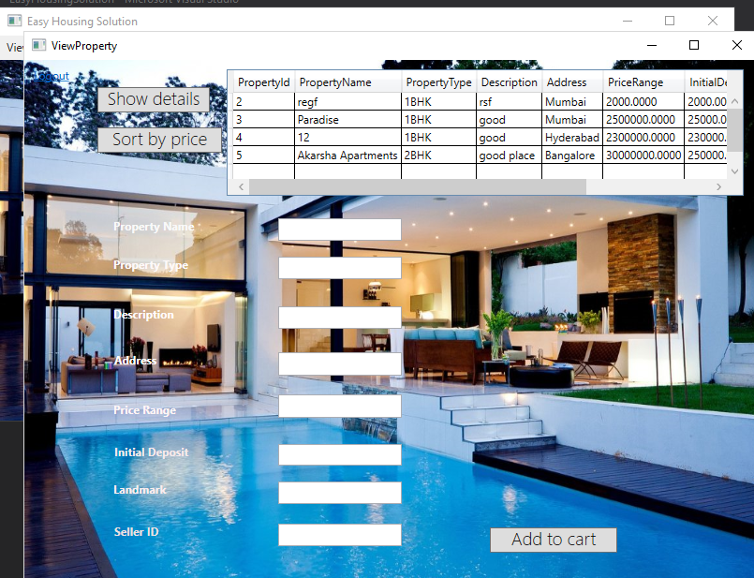
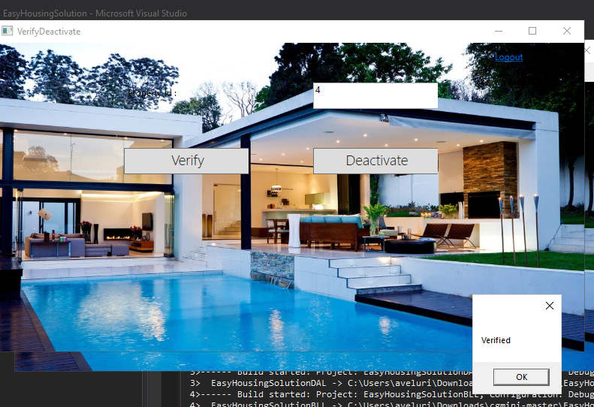

Slide 12
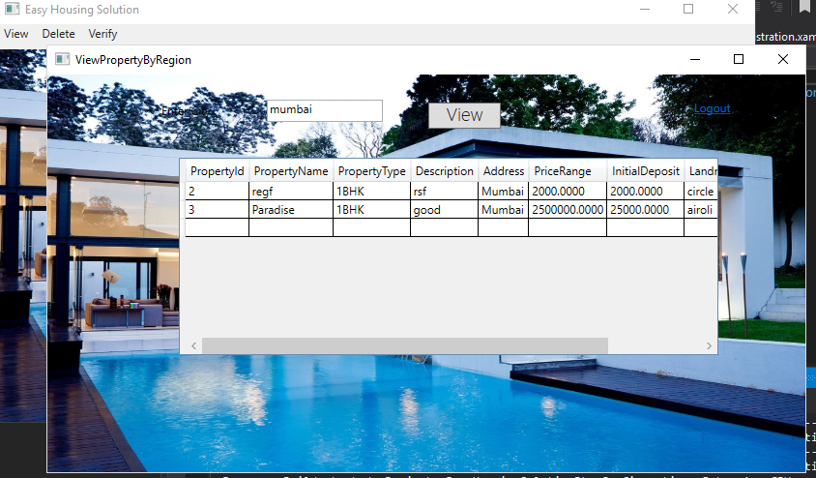

Slide 13
MODULES
ADMIN
Admin have rights to verifying property.
And also admin can have right to deactive property.

Slide 14
MODULES
Buyer
Buyer can visit the Site and search for property. But to buy or rent a particular property he/she would have to register.
Buyer can search the property based on places.

Slide 15
MODULES
Seller
Seller would have to register themselves with Easy Housing Solution site.
Seller can add their properties .

Slide 16
LEARNING
Here in this project we have used ADO.Net and WPF to build the solution.
In this we project we learnt about the role of admin , seller and buyer.
To add styles and background images to the project wpf is used.
Learnt to connect database to the visual studio.
By using ADO.Net connected architecture we performed CRUD operations in data access layer.
Validation are given in business logic layer to validate the required fields.

Slide 17
OPPORTUNITY FOR IMPROVEMENT
Some of the improvements are:
Improvement for booking multiple tickets.
Showing revenue of the flights.

Slide 18
BEST PRACTICES
In this project I have used Layered architecture to build the solution.
In entity layer we need to give the variables.
In exception exception layer handles the exceptions occurred in the application.
In Data access layer all the CRUD operations are done.
In Business access layer all the validations were performed.
Naming conventions were given right and are understandable so there are no mistakes in the naming.

